Slide 1

FACIAL EXPRESSION ANALYSIS WITH SMART SONG PLAYER
Vadlamudi Sai Lokesh(RA1811027010069)
Kotha Sai Narasimha Rao(RA1811027010070)
Guide: Dr.L. Anand

Slide 2
INTRODUCTION
Face recognition models are developed in recent years rapidly since most of the deep learning applications engaged in today’s world are formulated with face recognition frameworks. Despite many face recognition datasets available publicly, Live face recognition also created more interest in research. In a similar context, obtaining facial landmark detection is one of the methods to achieve a face recognition system[1]. Face reconstruction is an art of image processing technology and deep learning technology. Creating accurate geometry is mandatory in facial reconstruction. To formulate the face expressions accurately, face landmarks mapping is an impacted task. Identification of face geometry is important to conclude the facial expressions[2].

Slide 3
ABSTRACT
Human face recognition is one of the important tasks in social communications. face expressions directly reflect human emotion. Face expressions are helpful to identify the real feeling of the person during a certain situation. Face expressions are key for indirect communication. The proposed system is focused on creating a robust Architecture using VGG Net. The system considers a face expression dataset (FER 2013) for analyzing the present model. The proposed architecture extracts and learns various unique expressions from the facial images available in FER 2013. The feature mapped values are further used to train and model the VGG net-enabled deep convolution networks. The proposed model also considers a music recommendation framework. appropriate music recommendations are done to the various expressions made by the person. The system achieved a higher accuracy of 92% and compared with existing state of art approaches to performance metrics.

Slide 4
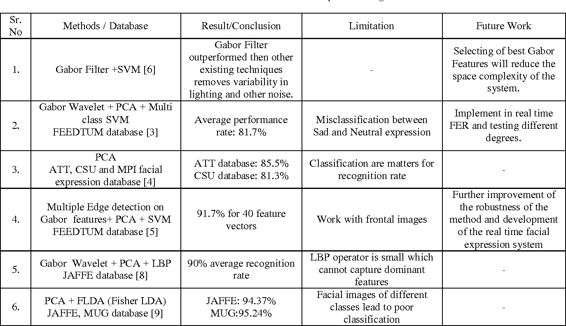
LITERATURE STUDY

Slide 5
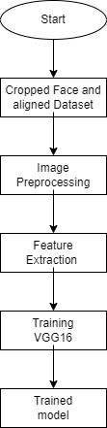
UML DIAGRAM FOR TRAINING

Slide 6
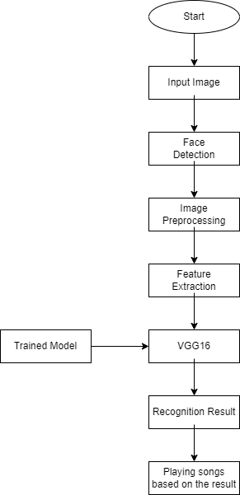
UML DIAGRAM FOR TESTING

Slide 7
MODULES
1.FACE DETECTION
2.EMOTION RECOGNITION
3.EMOTION RECOGNITION WITH SOUND

Slide 8
FACE DETECTION
In order to predict the expression correctly ,first and foremost the face has to be detected
To check which algo works best for this task we tested it out with four different approaches
1)HaarCascade
2)LBPCascade
3)Dlib with HOGDetector
4)Opencv DeepLearning based Face Detection(DNN)

Slide 9
Comparative Analysis
HaarCascade:
Works almost real-time on CPU
Architecture Detects faces at different scales
Works well even in the bad lighting conditions
LBP:
Less accurate than HaarCascade
May misses Some faces in the photo

Slide 10
Comparative Analysis
Dlib with HOG:
1)It works well for images which the face is close.if the face is bit far it will not detect the face
DNN:
1)If we talk strictly about face detection its the best out of four but if we talk about frontal face detection HaarCascade is better. In our project in order to predict expression the frontal face has to detect well

Slide 11
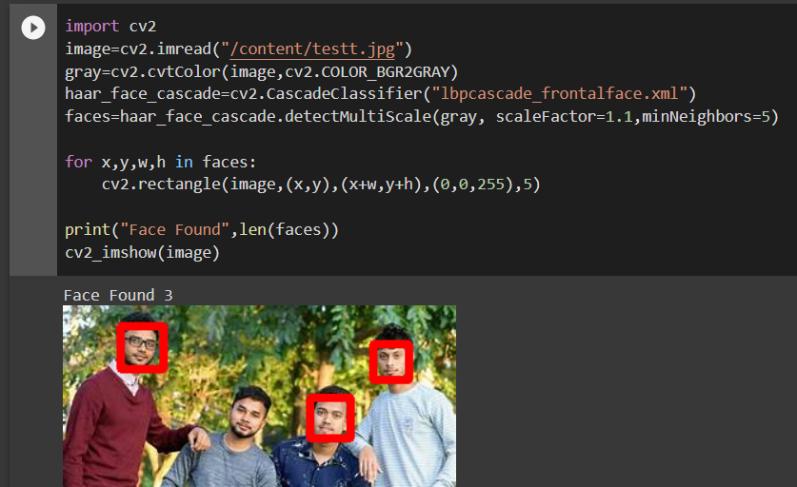
LBP CASCADE

Slide 12
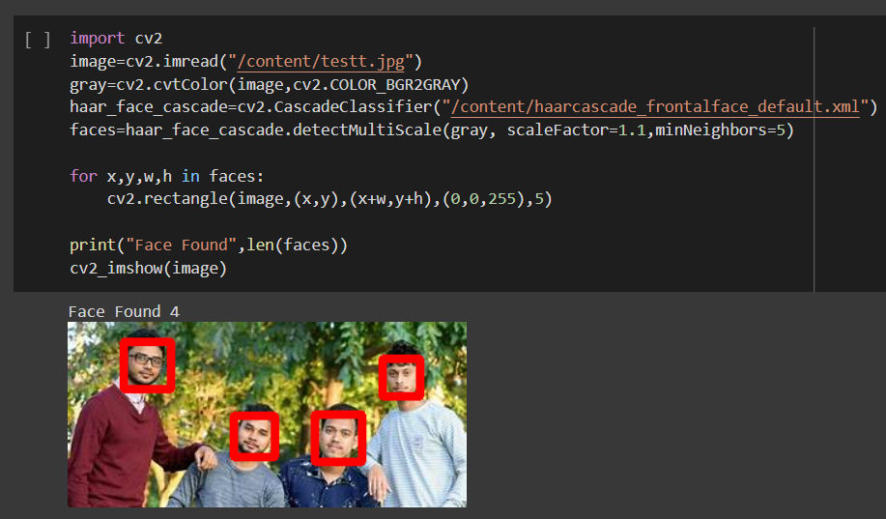
HAARCASCADE

Slide 13
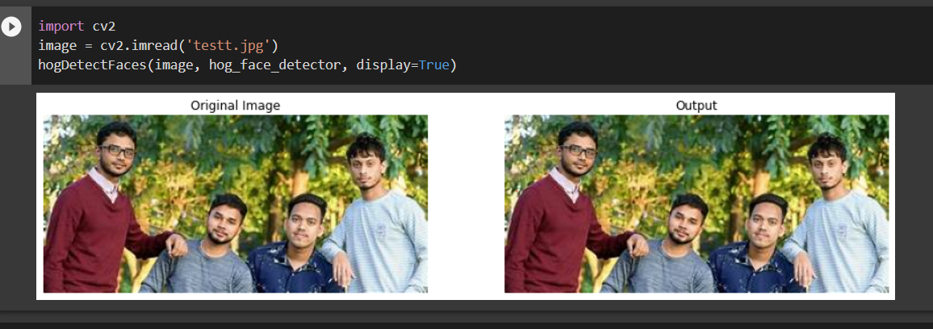
DLIB with HOG

Slide 14
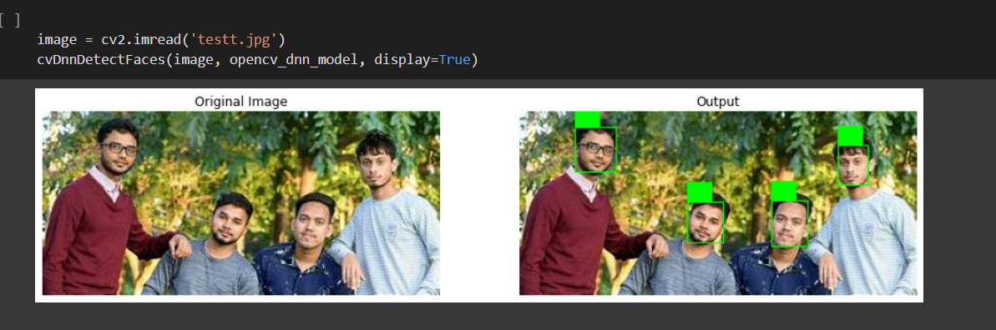
DNN

Slide 15
EMOTION RECOGNITION
In order to classify the emotion we used four different approaches to test it out the best model for us
1)BASE SEQUENTIAL MODEL(Using Keras)
2)RESNET
3)VGG16
4)EFFICIENTNETB0

Slide 16
BASE MODEL
This is the Keras Sequential Model where instead of following a specified architecture we manually build the layers.
The advantage of this model is we can build any of the other models on top of this model to improve accuracy

Slide 17
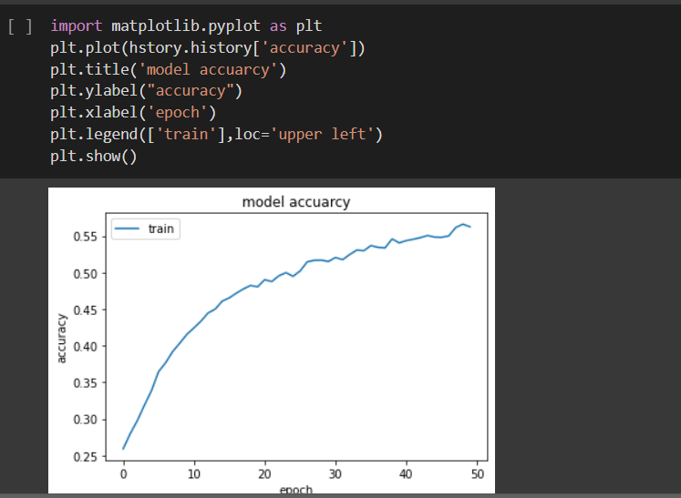
BASE MODEL

Slide 18
RESNET
ResNet50 is a variant of ResNet model which has 48 Convolution layers along with 1 MaxPool and 1 Average Pool layer. It has 3.8 x 10^9 Floating points operations.
A Residual Neural Network (ResNet) is an Artificial Neural Network (ANN) of a kind that stacks residual blocks on top of each other to form a network.
The network has an image input size of 224-by-224.

Slide 19
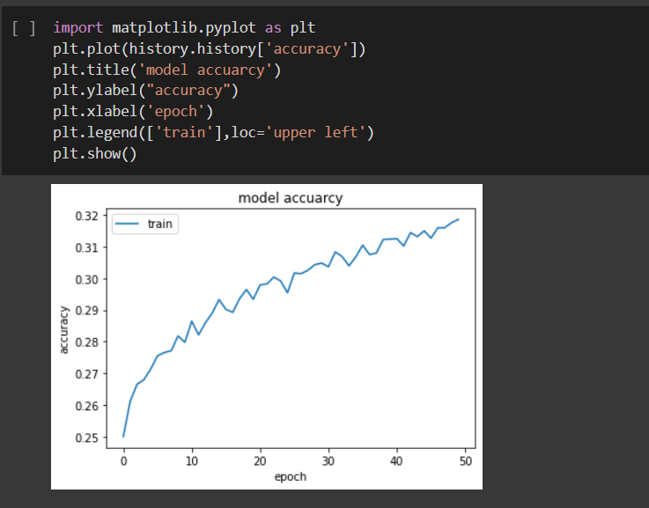
RESNET MODEL

Slide 20
EFFICIENTNETB0
EfficientNet is a convolutional neural network architecture and scaling method that uniformly scales all dimensions of depth/width/resolution using a compound coefficient. Unlike conventional practice that arbitrary scales these factors, the EfficientNet scaling method uniformly scales network width, depth, and resolution with a set of fixed scaling coefficients. For example, if we want to use 2N times more computational resources, then we can simply increase the network depth by αN , width by βN , and image size by γN, where α,β,γ are constant coefficients determined by a small grid search on the original small model. EfficientNet uses a compound coefficient ϕ to uniformly scales network width, depth, and resolution in a principled way
The compound scaling method is justified by the intuition that if the input image is bigger, then the network needs more layers to increase the receptive field and more channels to capture more fine-grained patterns on the bigger image.

Slide 21
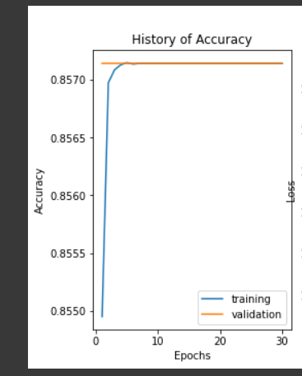
EFFICIENTNETB0
MODEL

Slide 22
VGG16
Most unique thing about VGG16 is that instead of having a large number of hyper-parameter they focused on having convolution layers of 3x3 filter with a stride 1 and always used same padding and maxpool layer of 2x2 filter of stride 2. It follows this arrangement of convolution and max pool layers consistently throughout the whole architecture. In the end it has 2 FC(fully connected layers) followed by a softmax for output. The 16 in VGG16 refers to it has 16 layers that have weights. This network is a pretty large network and it has about 138 million (approx) parameters.

Slide 23
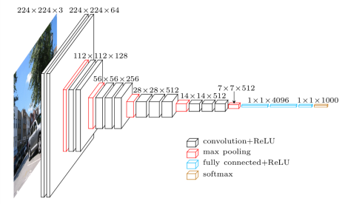
VGG16

Slide 24
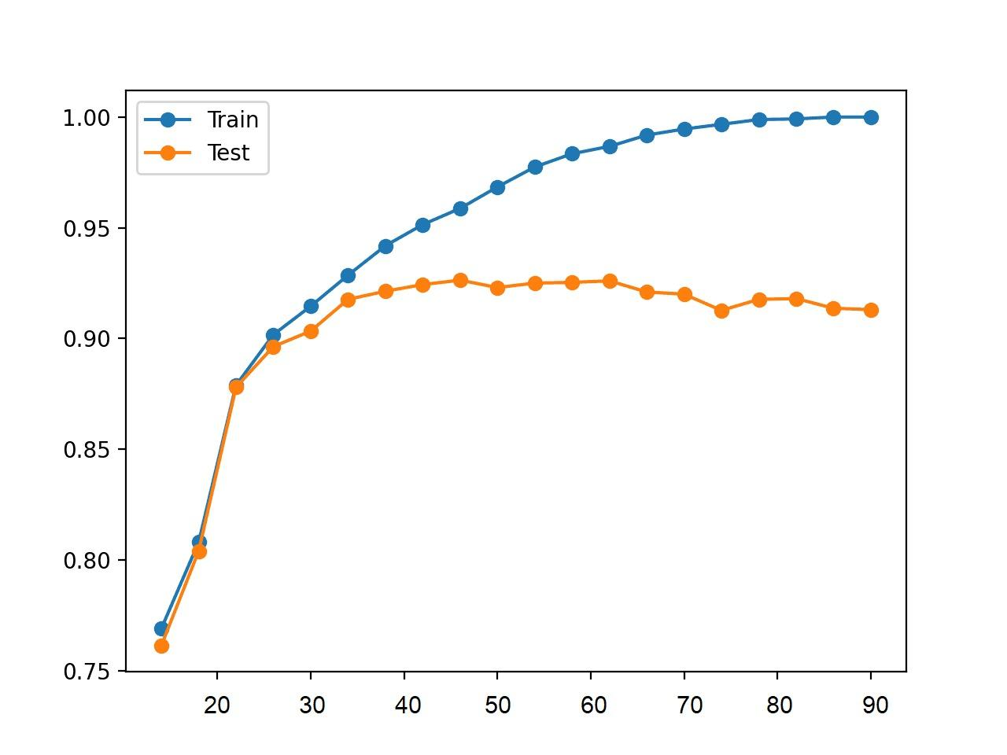
VGG16 MODEL

Slide 25
Comparative Analysis
1)Base Sequential Model gave the accuracy 59 percent
2)RESNET gave the accuracy 35 percent
3)EFFICIENTNET B0 gave the accuracy of 87 percent
4) VGG16 gave the accuracy of 92 percent

Slide 26
Playing Song
Playsound:
The playsound module contains only a single function named playsound().
It requires one argument: the path to the file with the sound we have to play. It can be a local file, or a URL.
There’s an optional second argument, block, which is set to True by default. We can set it to False for making the function run asynchronously.
It works with both WAV and MP3 files.

Slide 27
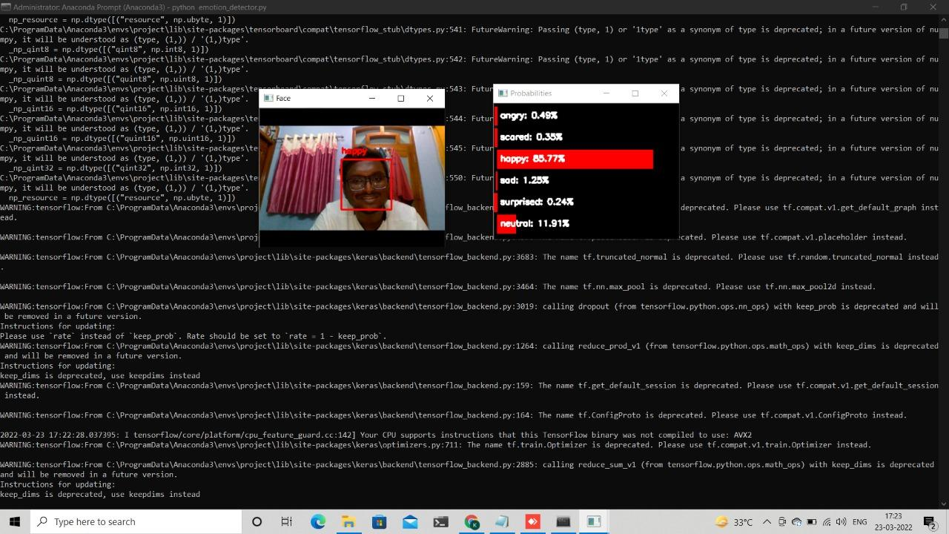
RESULT AND DISCUSSION
HAPPY

Slide 28
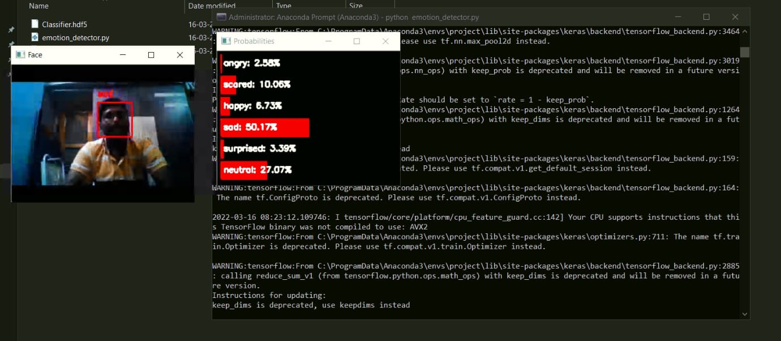
OUTPUT
SAD

Slide 29
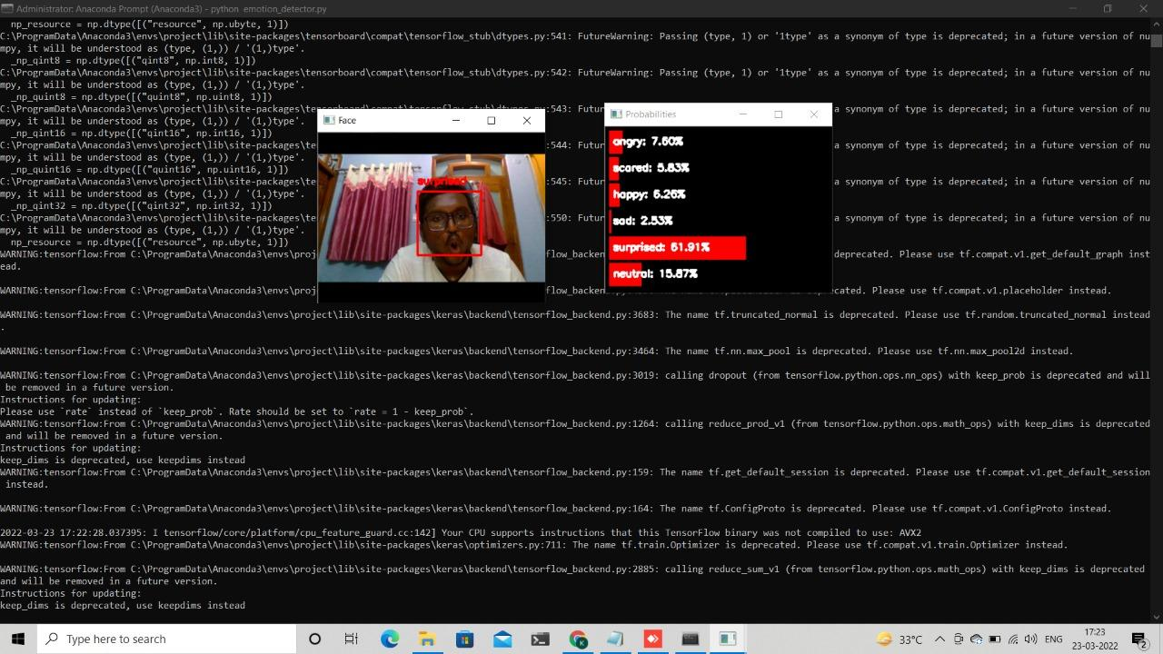
OUTPUT
SURPRISED

Slide 30
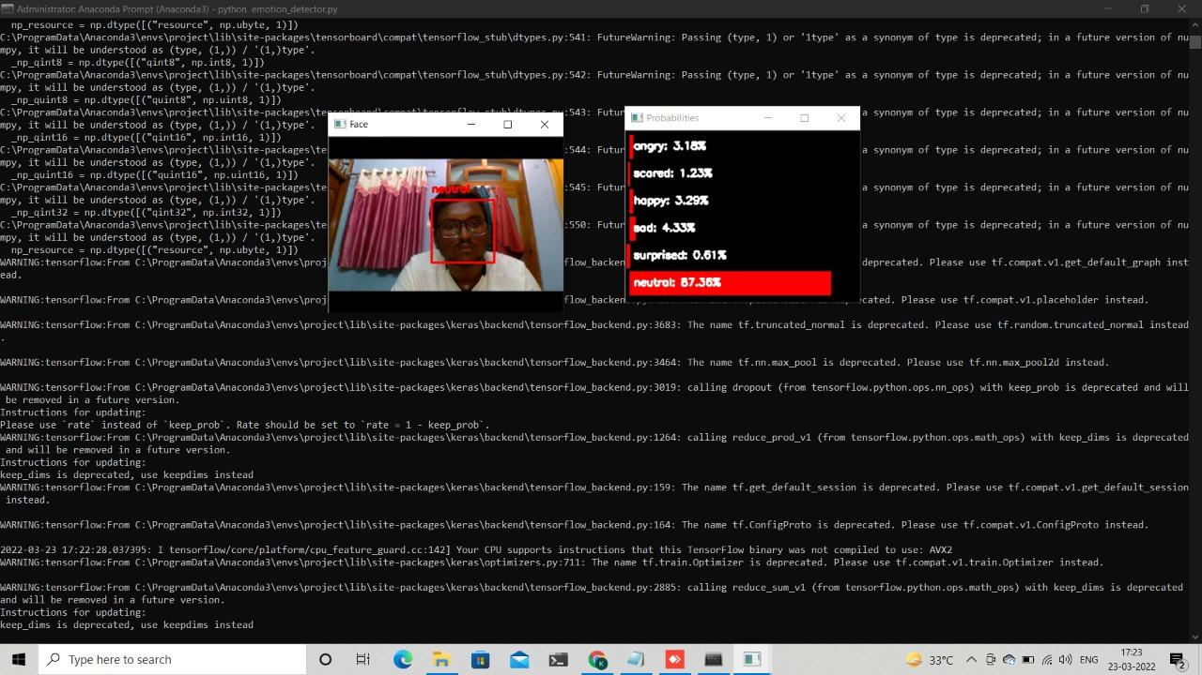
OUTPUT
NEUTRAL

Slide 31

OUTPUT
ANGRY

Slide 32
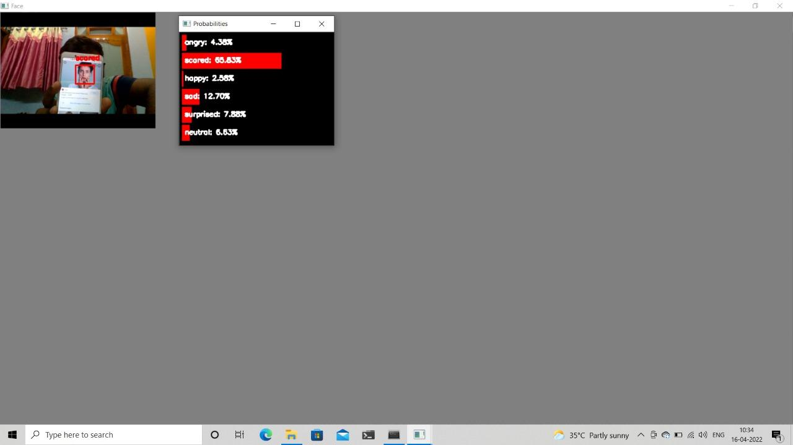
OUTPUT
SCARED

Slide 33
CONCLUSION
Emerging technologies utilized artificial intelligence enabled systems for many products. Various core products depend on face recognition for security and sourcing. Face recognition systems act as one of the foremost needs in many real time emerging products. Facial expressions are helpful for making automated reviews of online courses, products, also to detect the emotional effect of the individuals. expressions are a direct impact of emotions. The proposed framework is modeled using Modif-VGG16 network for facial expression detection as well as the Saddle point recommendation framework for music suggestions. The proposed structure is validated with the FER-2013 dataset. The System achieved the accuracy of 92% on an average and further the system can be improved with more real time dataset with the help of transfer learning approaches.

Slide 34
REFERENCES
[1] F. Liu, Q. Zhao, X. Liu and D. Zeng, "Joint Face Alignment and 3D Face Reconstruction with Application to Face Recognition," in IEEE Transactions on Pattern Analysis and Machine Intelligence, vol. 42, no. 3, pp. 664-678, 1 March 2020, doi: 10.1109/TPAMI.2018.2885995.
[2] M. Emambakhsh and A. Evans, "Nasal Patches and Curves for Expression- Robust 3D Face Recognition," in IEEE Transactions on Pattern Analysis and Machine Intelligence, vol. 39, no. 5, pp. 995-1007, 1 May 2017, doi: 10.1109/TPAMI.2016.2565473.
[3] F. Qu, S. Wang, W. Yan, H. Li, S. Wu and X. Fu, "CAS(ME)$^2$ : A Database for Spontaneous Macro-Expression and Micro-Expression Spotting and Recognition," in IEEE Transactions on Affective Computing, vol. 9, no. 4, pp. 424-436, 1 Oct.-Dec. 2018, doi: 10.1109/TAFFC.2017.2654440
016.7987972

Slide 35
REFERENCES
[4] M. Wairagkar et al., "Emotive Response to a Hybrid-Face Robot and Translation to Consumer Social Robots," in IEEE Internet of Things Journal, vol. 9, no. 5, pp. 3174-3188, 1 March1, 2022, doi: 10.1109/JIOT.2021.3097592.
[5] S. Tulyakov, L. A. Jeni, J. F. Cohn and N. Sebe, "Viewpoint-Consistent 3D Face Alignment," in IEEE Transactions on Pattern Analysis and Machine Intelligence, vol. 40, no. 9, pp. 2250-2264, 1 Sept. 2018, doi: 10.1109/TPAMI.2017.2750687.
[6] R. Zatarain-Cabada, M. L. Barrón-Estrada, F. González-Hernández and H. Rodriguez-Rangel, "Building a Face Expression Recognizer and a Face Expression Database for an Intelligent Tutoring System," 2017 IEEE 17th International Conference on Advanced Learning Technologies (ICALT), 2017, pp. 391-393, doi: 10.1109/ICALT.2017.141.

Slide 36
THANK YOU

